Slide 1
FOOD TRACKING SYSTEM
Presented By:
V. Krishnamoorthy (AU510520104022)​
S. Balaji (AU510520104008) ​
R. Dinesh(AU510520104013) ​
S. RanjithKumar (AU510520104024)​

Slide 2
ABSTRACT
A food shortage, which has increased with the climate crisis, will be one of the biggest problems of the world, together with water scarcity, in the future and will damage the sustainability of the food supply system.
The importance of food tracking even more. The exorbitant price increases after the COVID-19 pandemic are the most concrete indicators

Slide 3
INTRODUCTION
In this study, the establishment of a block chain-based food tracking system in Turkey, its operation, and its results will be discussed. It was concluded that 97.54%
The participants using the established system found the application useful and wanted such an application to become widespread.

Slide 4
PURPOSED SYSTEM
To define block chain technology, it is technology that eliminates the need for a central trust or authority, allowing trust to be distributed participants In the system.
The hash code of the block, the hash code of the previous block, the index information, and the nonce value.

Slide 5
EXISTING SYSTEM
Focus on the increasingly serious problem of food safety in China and propose a block chain solution for the agriculture supply chain, based on the information and transaction security between all the involved parties.
The significance of voluntary traceability is highlighted, focusing on the volume and the quality of the data collected for each product

Slide 6
REQUIREMENT SPECIFICATION
Hardware Requirements :
• Processor: AMD PRO A4-4350B R4, 5 Computer Cores 2C+3G.
• Memory(Ram):4 GB Ram.
• System: 64-Bit Operating System.
Software Requirements :
• Operating System: Windows 10.
• Programming Languages: React js , Blockchain .
• Text Editor: Microsoft Visual Code & Sublime Text.
• Hosting and Deployment: GitHub or Webhost000.

Slide 7
PROJECT OVERVIEW
The awareness of protecting human health, which has increased on a global scale in recent years, has also shown itself in the food industry, and it has gained great importance that food be safe in order to lead a healthy life
Food safety covers the whole process from the production stage of the food until it reaches the consumer

Slide 8
PROBLEM SATEMENT DEFINITION
A problem statement is a brief and concise explanation of a problem that needs to be addressed.
The lack of an efficient and user-friendly food tracking system makes it difficult for people to monitor their food intake and achieve their nutritional goals
It can also help users identify food allergies and intolerances, and provide recommendations for healthier food choices

Slide 9
FUNCTIONAL REQUIREMENTS
Customers should be able to view the status of their orders, including when they were placed, when they are expected to be ready, and when they have been delivered (if applicable).
Order modification: Customers should be allowed to make changes to their orders until they are ready for preparation by the kitchen.
Customers should be able to choose goods from the menu and add them to their order, as well as express any special instructions or alterations.

Slide 10
NON-FUNCTIONAL REQUIREMENT
Security: The system should prevent unauthorised access or misuse of sensitive information, such as consumer payment and personal information.
Scalability refers to the system’s ability to accommodate increases in the number of users or orders without deteriorating performance.
Reliability: The system should be available and working when required, with as little downtime as possible. This could include requirements for the system’s ability to handle failures

Slide 11
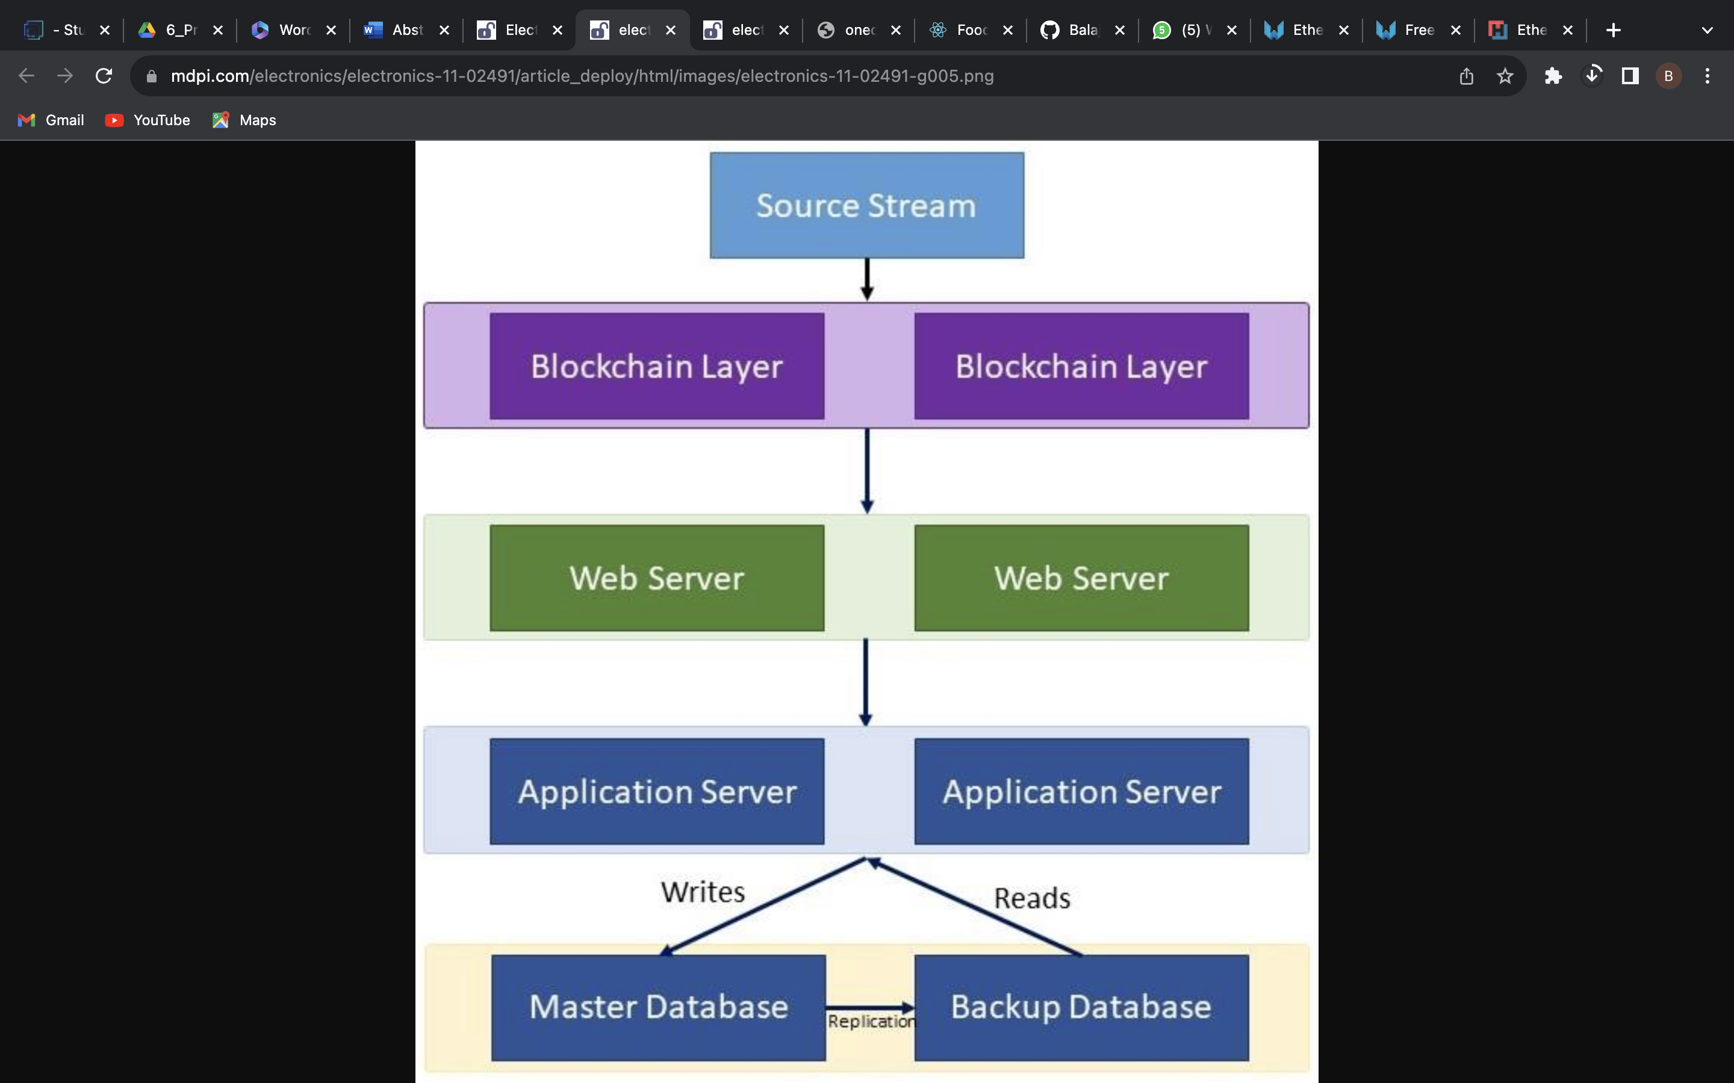
TECHNICAL ARCHITECTURE DAIGRAM

Slide 12
PROJECT DESIGNING
This article provides a detailed analysis of the component design and architecture of DoorDash, a popular prepared food delivery service. It discusses the data model, scalability, redundancy, fault tolerance, and other important pieces of the puzzle.
This research paper proposes a smart expiry food tracking system that uses RFID technology to track food expiration dates and reduce food waste.

Slide 13
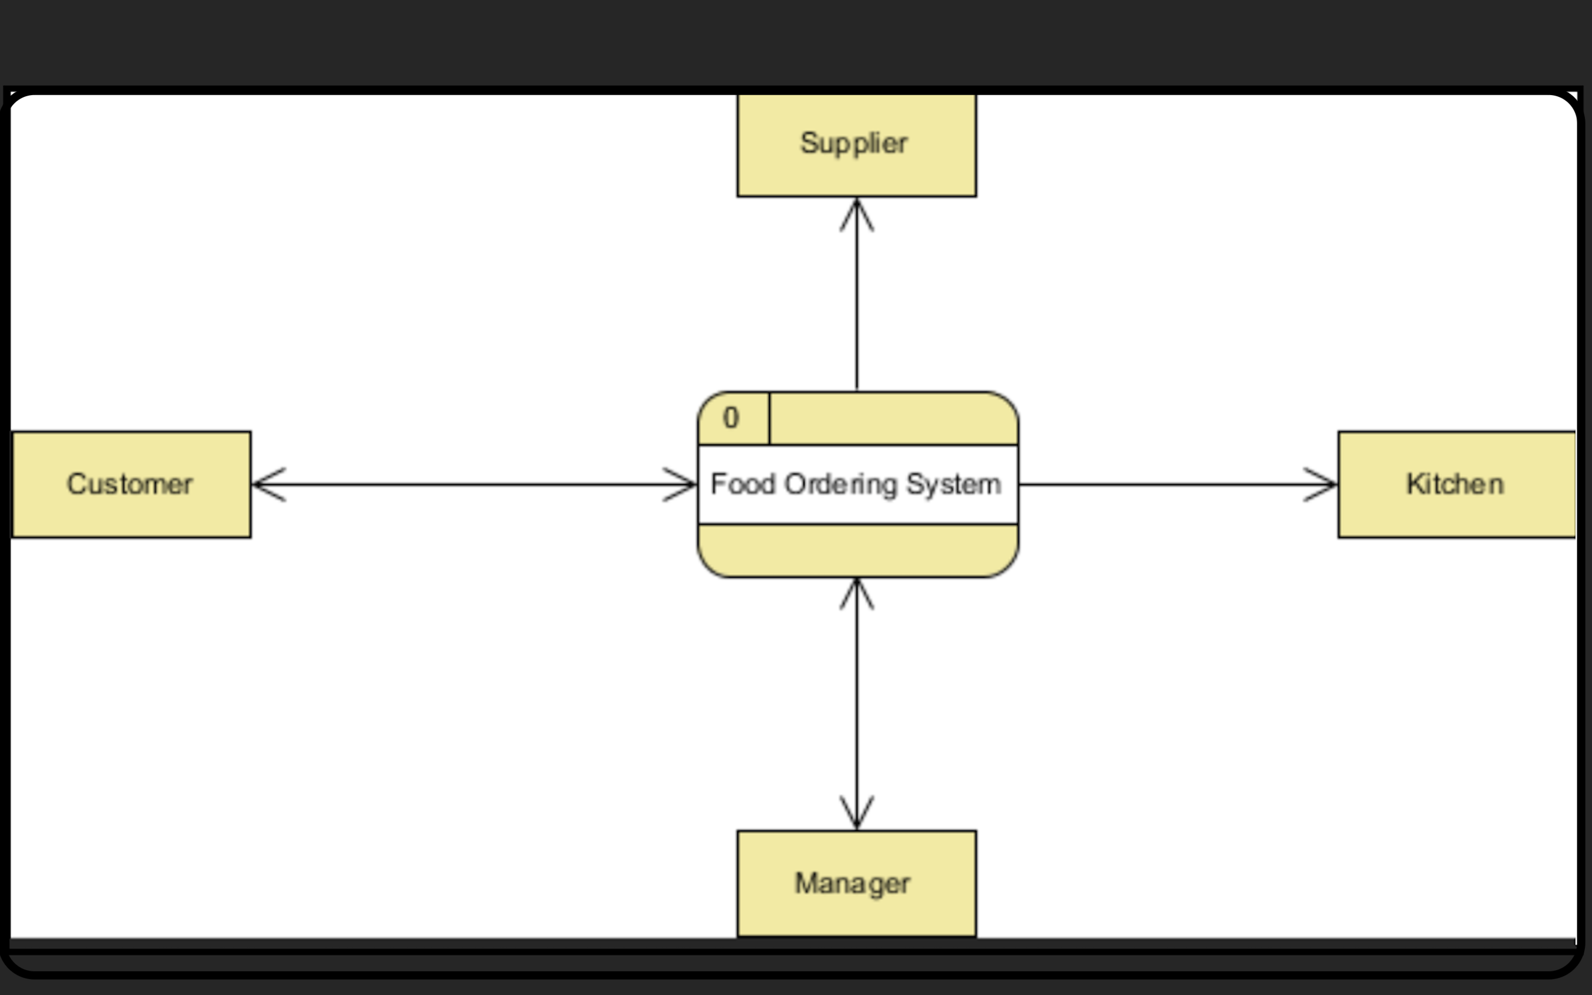
DATA FLOW DIAGRAM

Slide 14
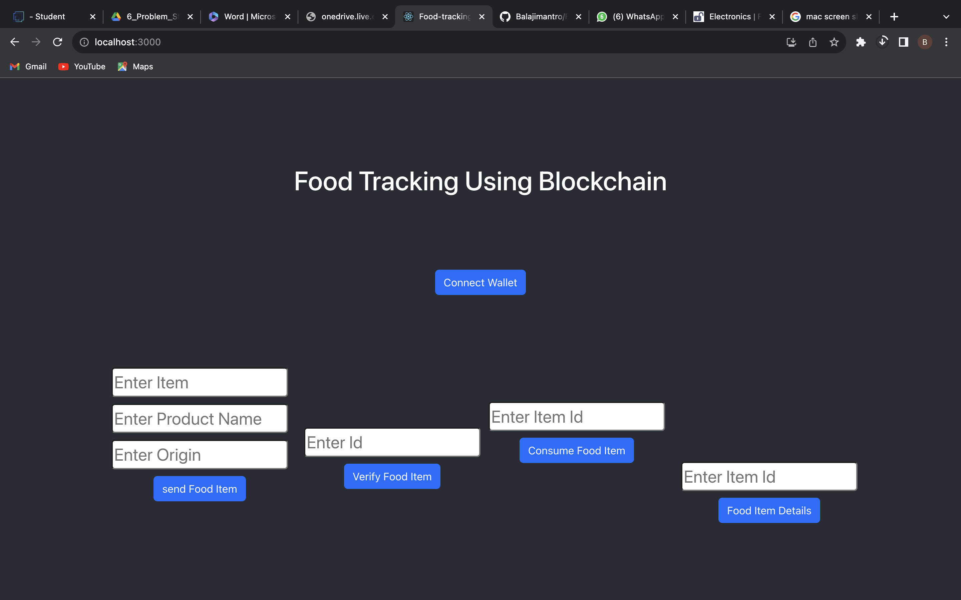
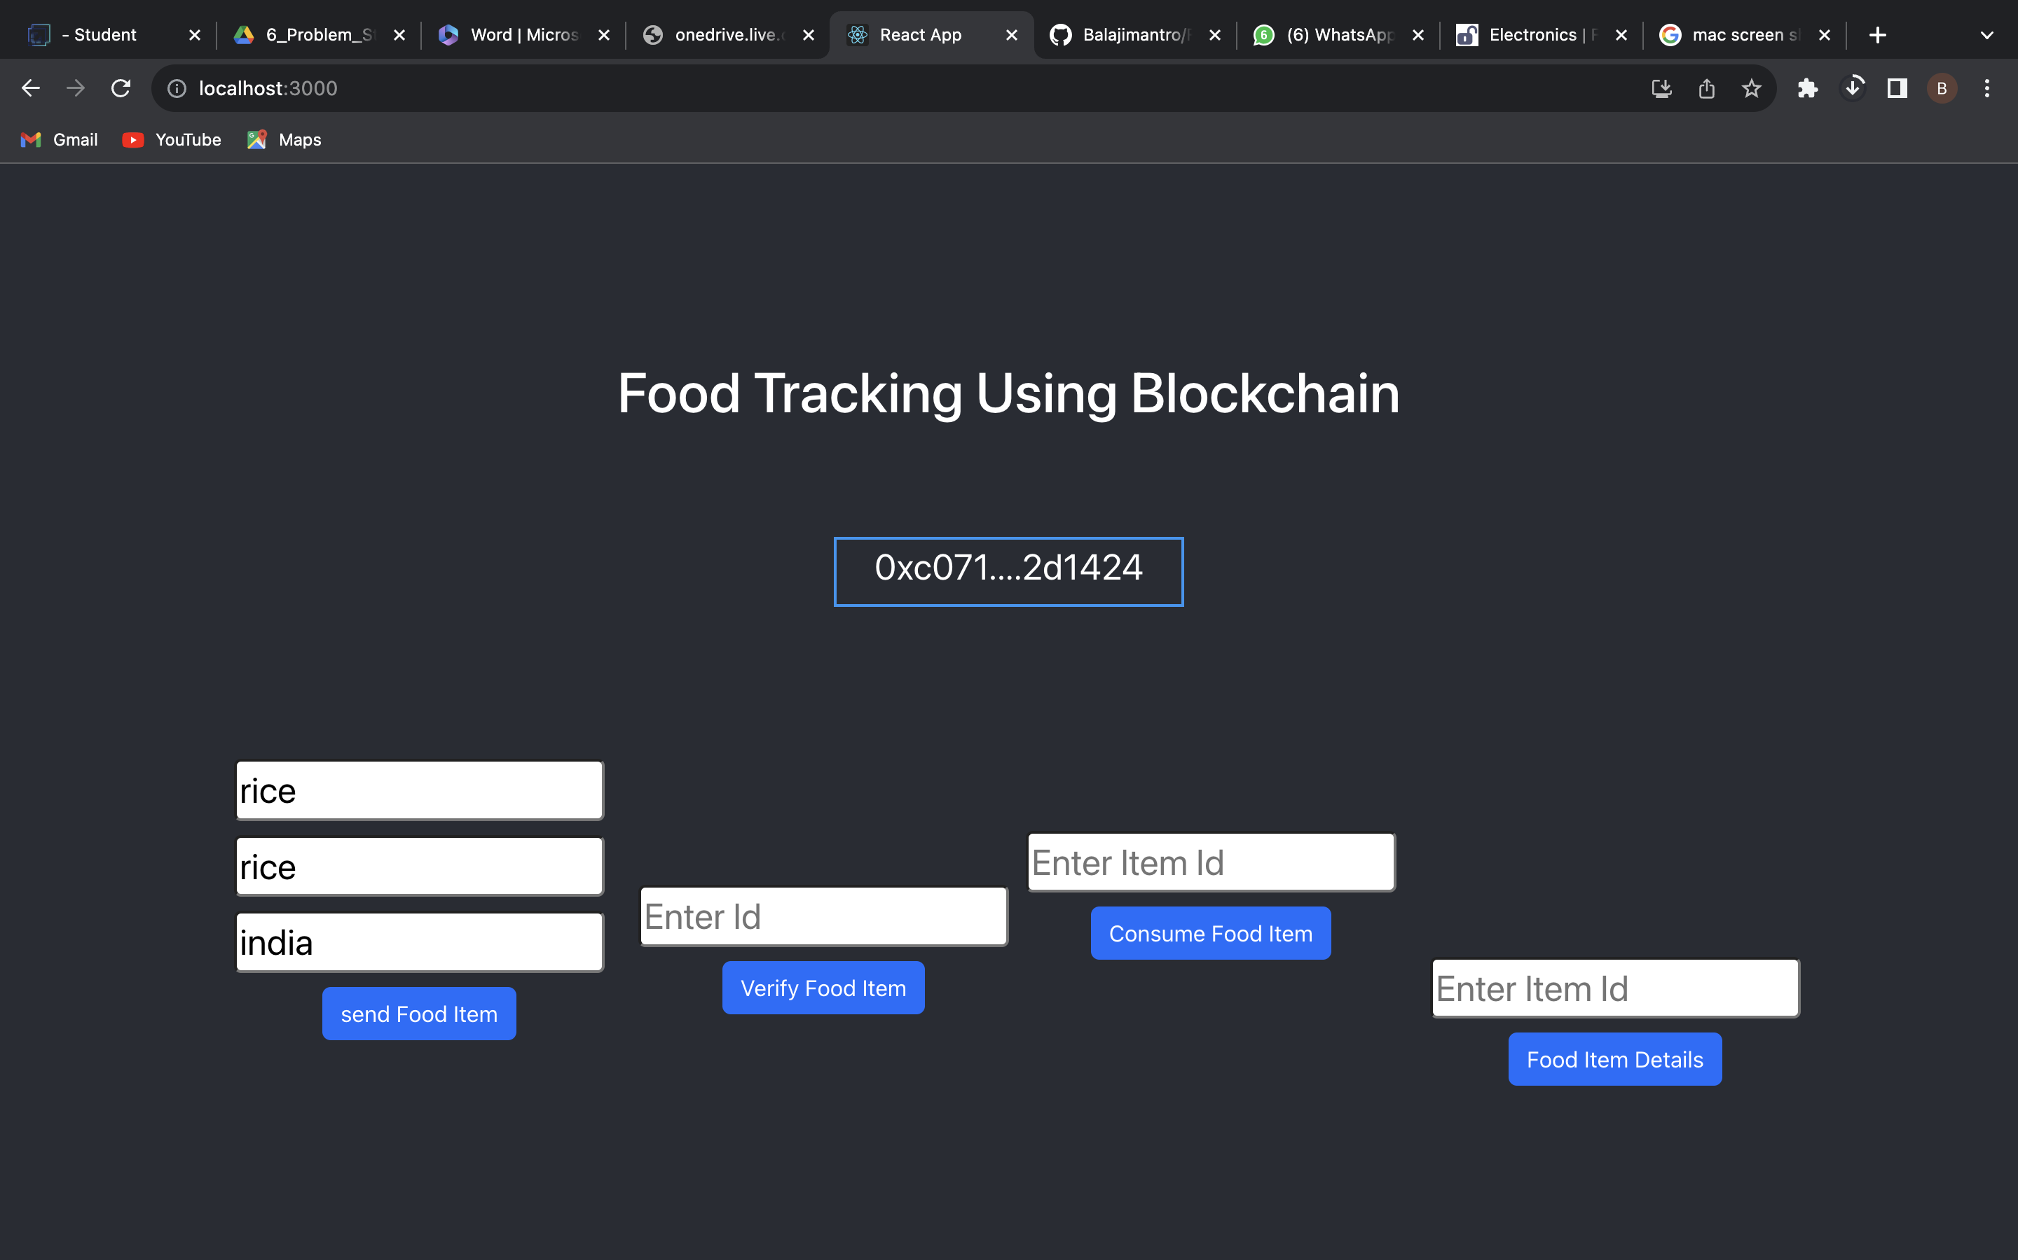
OUTPUT SCREENSHOTS

Slide 15
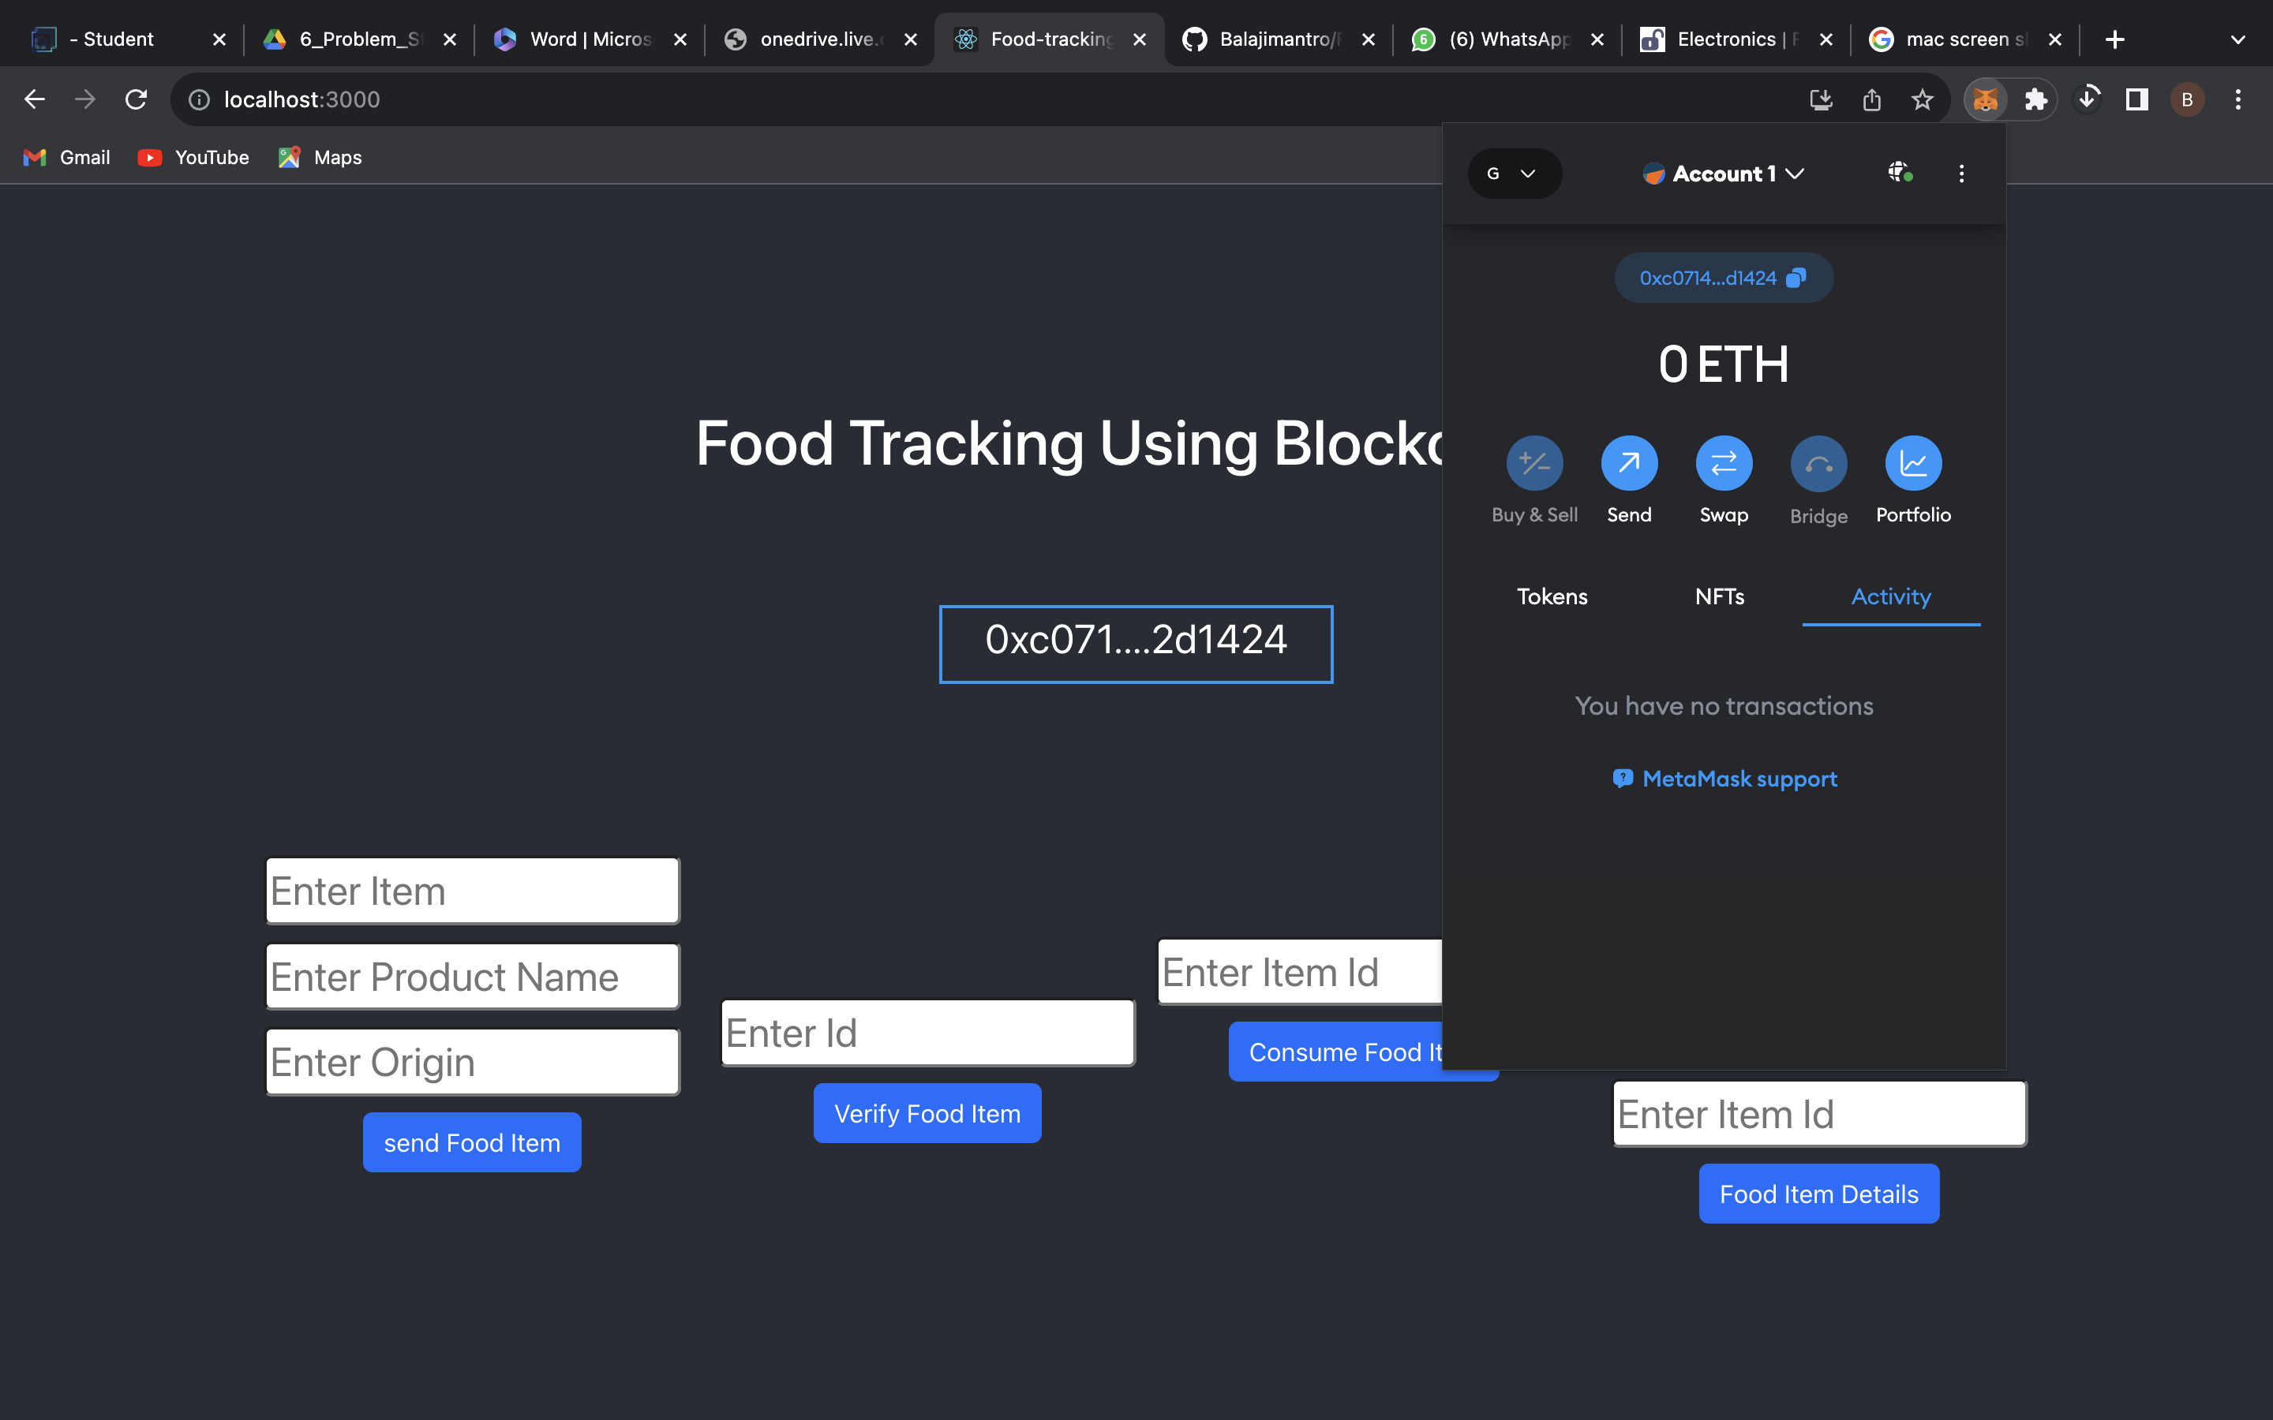
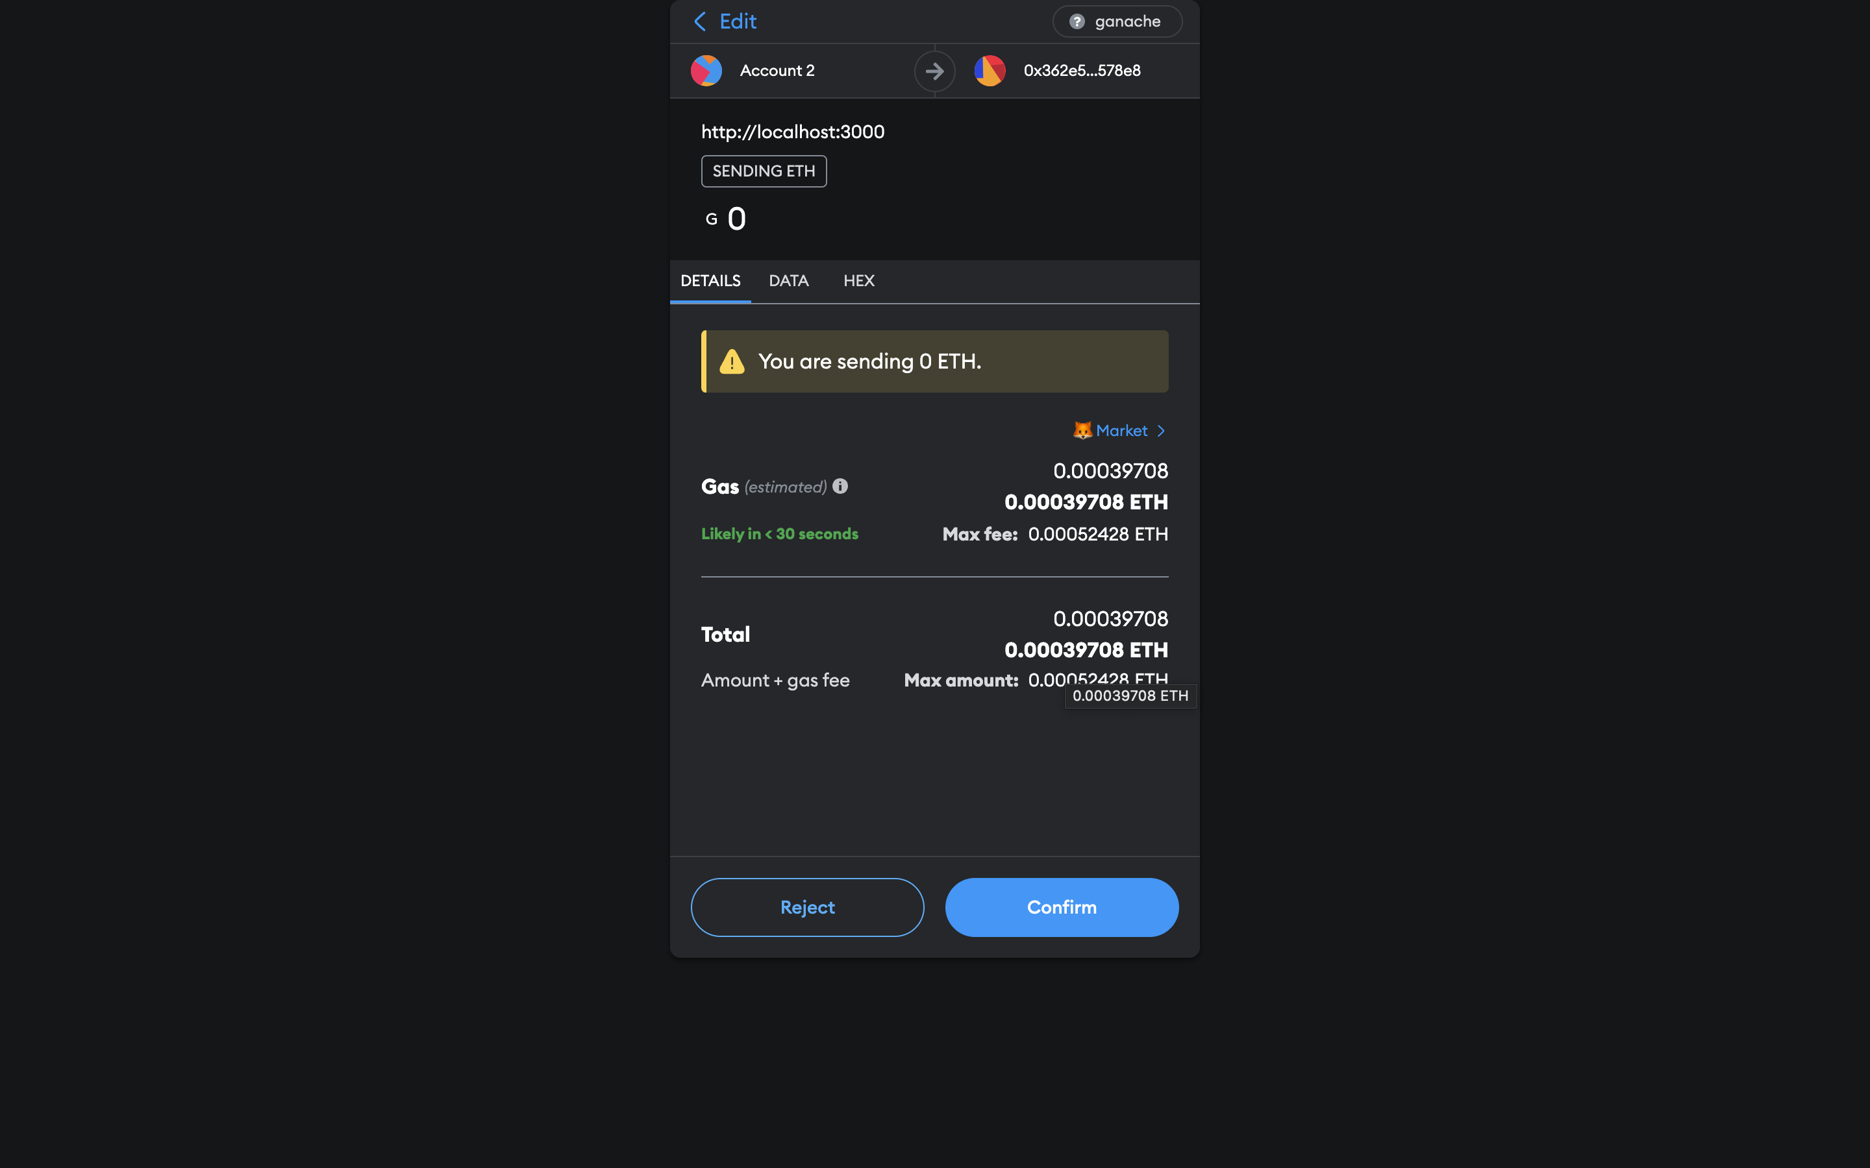
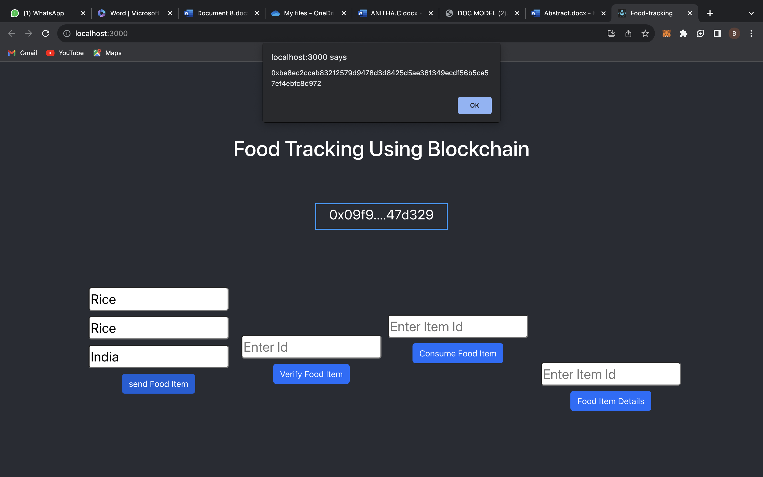

Slide 16
ADVANTAGES
*Improved Efficiency:* Streamlined order management and delivery tracking can enhance overall operational efficiency, reducing errors and improving delivery accuracy.
*Enhanced Customer Experience:* Real-time tracking and timely updates can lead to improved customer satisfaction, providing users with transparency and convenience throughout the ordering and delivery process.
*Data-Driven Insights:* The system can generate valuable data on customer preferences, popular items, and delivery patterns, enabling businesses to make informed decisions and tailor their services to meet customer demands effectively.

Slide 17
DISADVANTAGES
*Initial Implementation Cost:* Setting up a comprehensive food tracking system may require a significant initial investment in software development, hardware, and infrastructure, which can be a barrier for small businesses.
*Technical Challenges:* Integrating complex tracking functionalities may involve technical challenges, such as data synchronization, system integration, and ensuring data security, which can pose obstacles during implementation and maintenance.
*User Privacy Concerns:* Collecting and storing user data for tracking purposes may raise concerns about data privacy and security, potentially leading to apprehension among users and regulatory compliance issues.

Slide 18
CONCLUSION
In this study, the establishment of a block chain-based food tracking system in Turkey, its performance comparison, the operation of the system, and the results are discussed.
The flow of a food tracking system has been demonstrated in Turkey, and accordingly, the 12-step system flow required to develop a block chain-based food tracking system has been obtained.
A transmission per second value of 285, reception per second value of 335, and CPU load rate value of 19.22 are obtained with the proposed system

Slide 19
REFERENCES
Blockbusting is a fully distributed system that uses block chain technology in combination with IoT devices to collect and distribute traceability data.
The proposed solution was tested with two Reuther and Hyper ledger Saw tooth block chain platforms.
Blockbusting enables the integration of Io T and block chain technologies, creating transparent, fault-tolerant, immutable, and editable records which can be used for an agri-food traceability system

Slide 20
THANKING YOU

